Slide 1
Building models towards understanding cultural preferences in perceiving musical themes of children's stories
CALIMAG, Fritz
MENDOZA, Emir Christopher
NUNCIO, Graciel Myka
ONG, Mitchell
Adviser: DEJA, Jordan Aiko
Notes:
Emir

Slide 2
OUTLINE
Overview of Technology
Statement of the Problem
Objectives, Scopes & Limitations
Significance of the Research
Gantt Chart
Notes:
Emir

Slide 3
MUSICAL THEMES
MUSIC
THEME
Has the ability to embody themes through expression
An attribute, descriptor, element or concept (Vaismoradi et al., 2016)
Subjective in nature. Difficult to classify music accordingly (Yang & Chen, 2011)

Slide 4
THEMATIC ANALYSIS
Does not have a strict set of rules to follow
Used in qualitative research
(Braun et al., 2019)
Notes:
Emir

Slide 5
MUSIC EMOTION RECOGNITION
Music Information Retrieval (MIR) -> Features
Music Emotion Recognition (MER) -> Emotions
Notes:
Emir

Slide 6
CHILDREN’S MUSIC
Building a Model for Music classification in children’s stories using Neural Networks (Kim, 2019)
Gathering different audio samples from videos of Children’s Stories and classifying them into themes.
Notes:
Add examples of childrens stories with background songs
“They show honesty…. They show”
Graciel
We will follow a similar framework to Kim, Clone’s thesis which is (title)
We will be gethering and classifyginh them into 4 themes
Next slide.

Slide 7
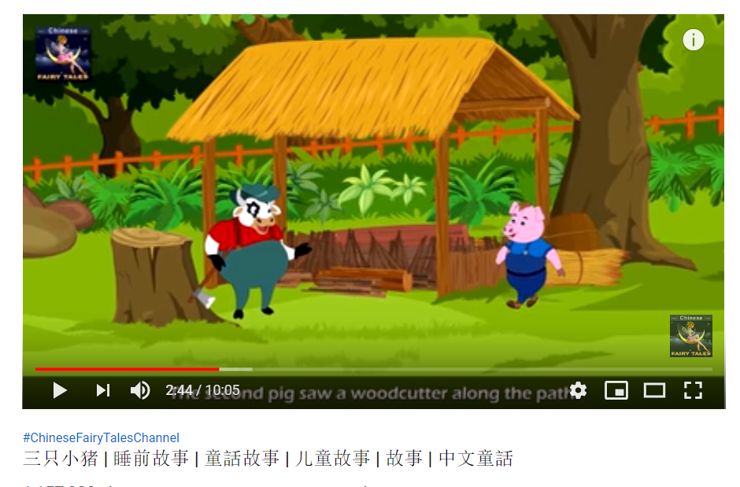

Theme
Examples
Cheerful Bravery
Fearful Love
Notes:
Graciel
They embody cheerful and fearful themes

Slide 8
CULTURAL Preferences
People tend to prefer music originating from their own culture (Brittin, 1996)
Cultural stereotypes associated with certain genres (Susino, 2018)
-More familiarity -> Less stereotyped emotions
Notes:
There are many factors to consider when analyzing music preferences and emotion recognition. Cultural differences is one such factor as mentioned in the work of \citeA{brittin1996listeners}. The work of \citeA{clarke2015music} discusses the capability of music to promote empathy and cultural understanding. They presented a model to connect the primary components of music and empathy research, which provides a good overview on how cultural differences are affected by music. People tend to prefer music originating from their own culture as familiarity and repeated exposure affect musical preference. Similarly, people's recognition of themes present in music also differ based on cultural upbringing.
Notes:
https://journals.sagepub.com/doi/pdf/10.1177/0305735618755886
Mitchell

Slide 9
STATEMENT OF THE PROBLEM
With the increasing demand for organization of music information, there are limited studies on the application of technology and children stories and how cultural preferences affect the perception of themes.
Notes:
1st point =
2nd point = the motivation for MER. instead of classifying via album name, genre, etc. we use emotions
3rd point = cross-cultural comparisons
Mitch

Slide 10
GENERAL OBJECTIVE
To train machine learning models that considers various Filipino-Chinese cultural influences in selecting themes in children’s stories.
Notes:
Mitch

Slide 11
Specific Objective 1
Scope and Limitations
To understand Filipino-Chinese cultural influences in children’s music by extracting samples of these music files and use them to build a data set.
Selecting a song for children aged 0-8
Extracting music samples that embody a specific theme
The themes will be labelled as in reference to Kim (2019)
Cheerful
Brave
Love
Fearful.
Each theme will have at least 100 music samples
Notes:
Define more what a segment is
Fritz

Slide 12
Specific Objective 2
Scope and Limitations
To build & train multiple machine learning models that aims to classify music for children's stories into four different themes.
A Cross Validation technique called K-fold will be used
The dataset for the model will be split into 3 parts
Training
Testing
Validation
We will use the experiments done by Kim (2019)
Neural Networks
Notes:
Cite clone’s use of neural nets here //follow the protocol used by…
Fritz

Slide 13
Specific Objective 3
Scope and Limitations
To evaluate the performance of the models in terms of its validity and accuracy.
Based on the work of Kim (2019) a comprehensive experiment design with a musical expert will be conducted to validate the correctness and acceptability of the model’s current iteration.
The results will be cross validated with a control group (Filipino People)
Notes:
Fritz

Slide 14
Significance of Research
Educators
Composers
Researchers
Notes:
Graciel

Slide 15

SONG LIST

Slide 16
the motivation on why we’re doing the thesis.
Why?

Slide 17
literature review of previous and existing works and the gaps
What?

Slide 18
proposed methodology with gantt chart all the way until october 2020.
How?

Slide 19
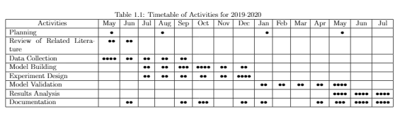
Time Table of Activities
Notes:
Graciel

Slide 20

Notes:
Graciel

Slide 21
Any Questions?
Notes:
Emir

